Slide 1
Support Vector Machines
Text Book Slides

Slide 2
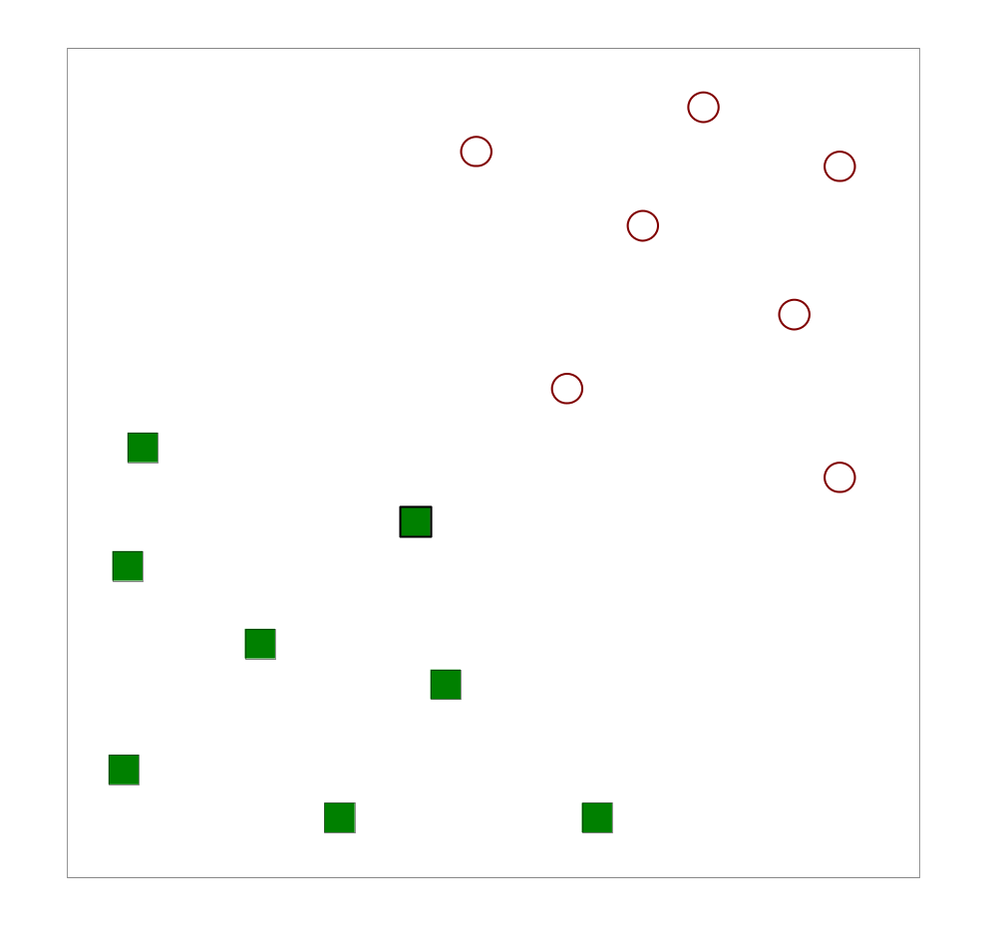
Support Vector Machines
Find a linear hyperplane (decision boundary) that will separate the data

Slide 3
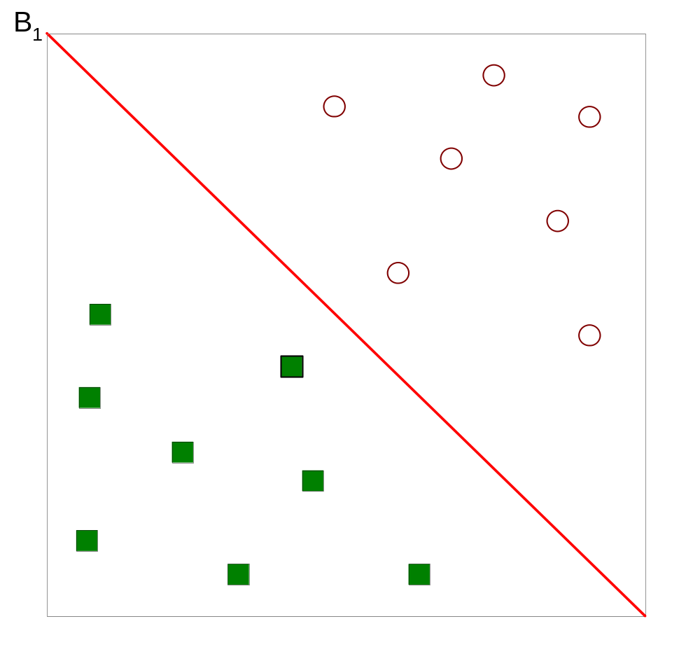
Support Vector Machines
One Possible Solution

Slide 4
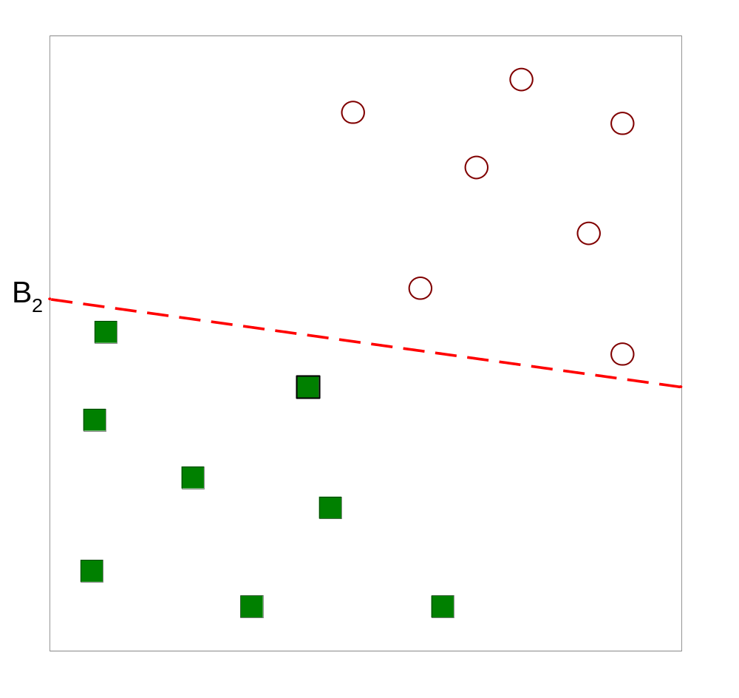
Support Vector Machines
Another possible solution

Slide 5
Support Vector Machines
Other possible solutions

Slide 6
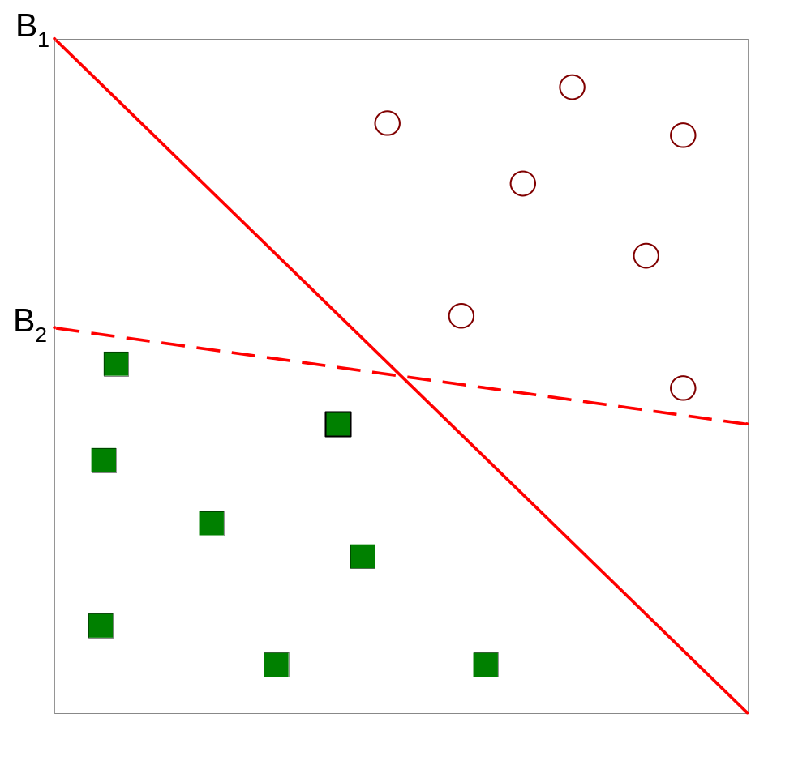
Support Vector Machines
Which one is better? B1 or B2?
How do you define better?

Slide 7
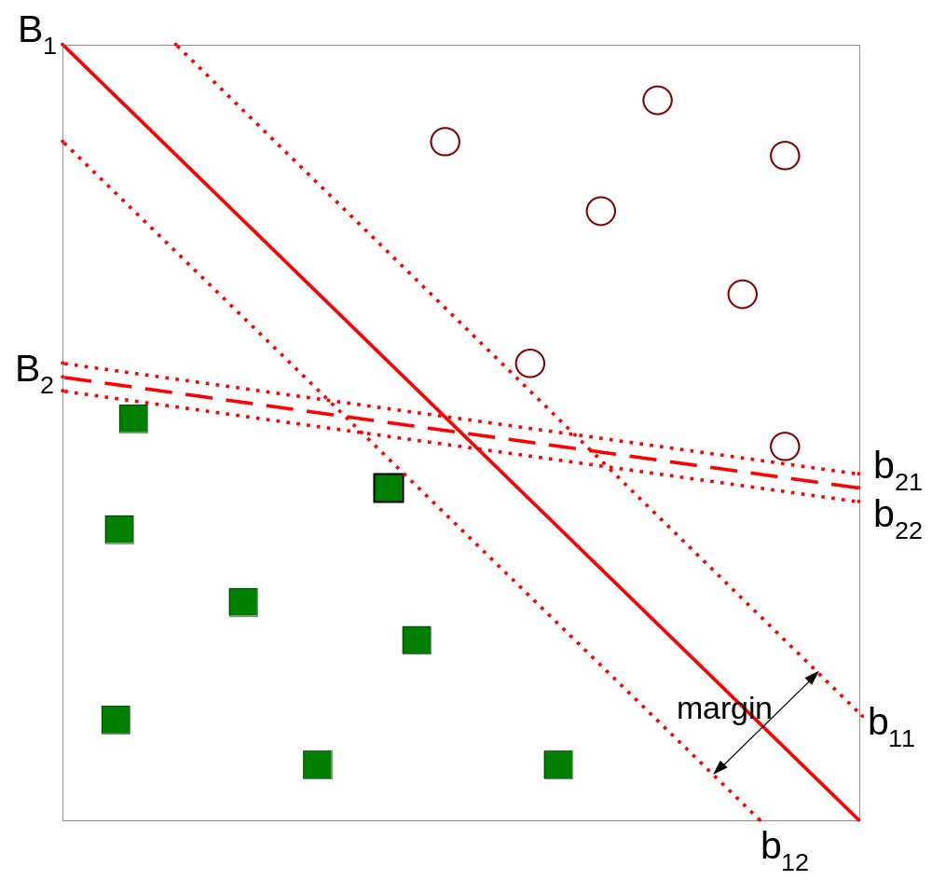
Support Vector Machines
Find a hyperplane that maximizes the margin => B1 is better than B2
Any Mathematical reason behind the philosophy of maximizing margin?

Slide 8
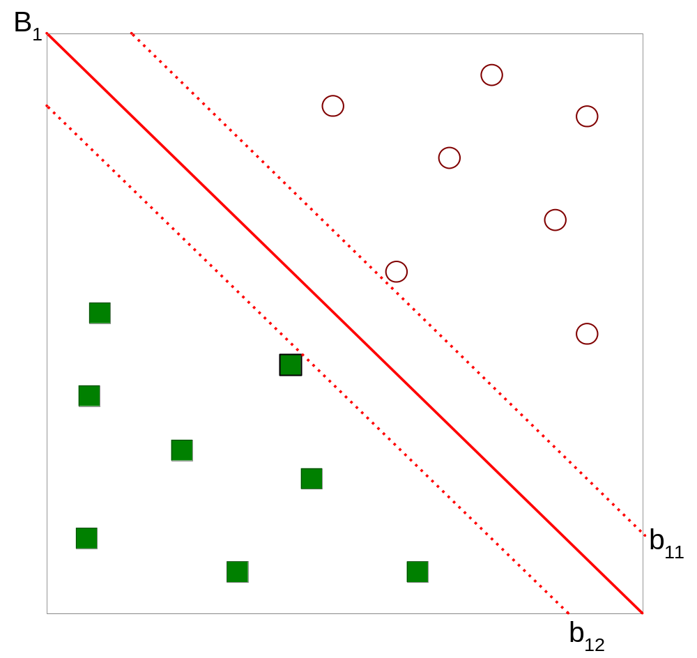



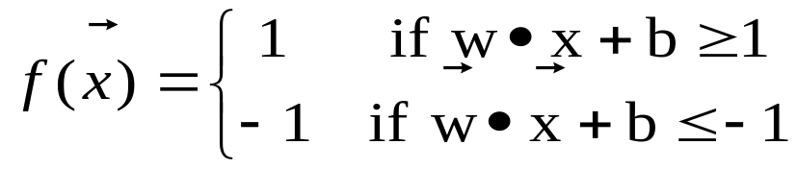
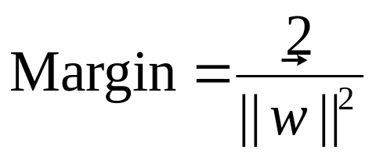
Support Vector Machines

Slide 9
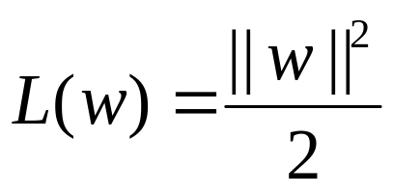
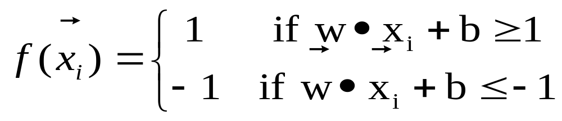
Support Vector Machines
We want to maximize:
  Which is equivalent to minimizing:
  But subjected to the following constraints:
    This is a constrained optimization problem
      Numerical approaches to solve it (e.g., quadratic programming)

Slide 10
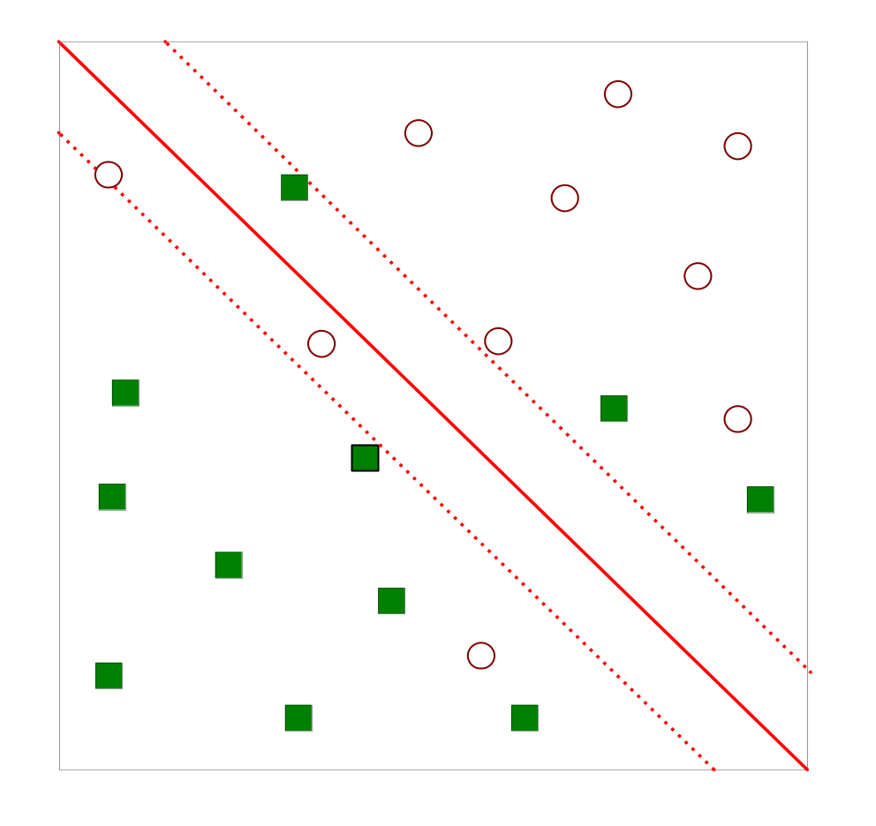
Support Vector Machines
What if the problem is not linearly separable?
How do you find out if the data is linearly separable or not????

Slide 11
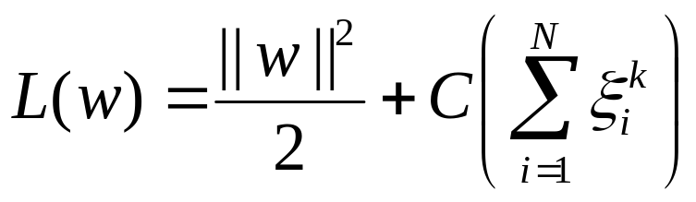
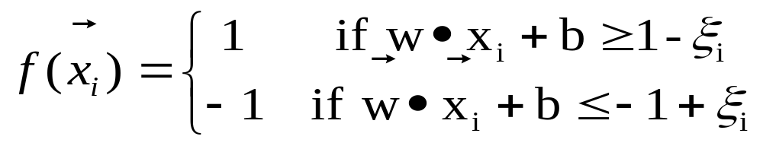
Support Vector Machines
What if the problem is not linearly separable?
  Introduce slack variables
    Need to minimize:
    Subject to:

Slide 12
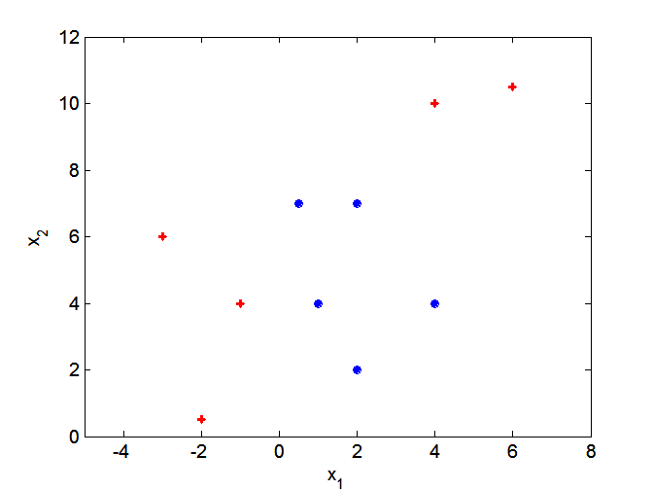
Nonlinear Support Vector Machines
What if decision boundary is not linear?

Slide 13
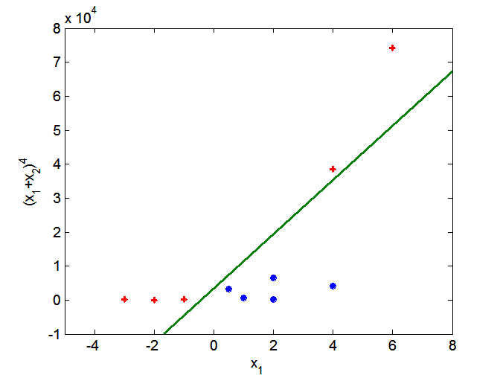
Nonlinear Support Vector Machines
Transform data into higher dimensional space

Slide 14
Support Vector Machines
To understand the power and elegance of SVMs, one must grasp three key ideas:
  Margins
  Duality
  Kernels

Slide 15
Support Vector Machines
Consider the simple case of linear classification
Binary classification task:
  Xi (i=1,2,…m)
  Class labels Yi (±1)
  d-dimensional attribute space
Let the classification function be:
f(x)=sign(w·x-b)
where vector w determines the orientation of a discriminant plane, scalar b is the offset of the plane from the origin
Assume that the two sets are linearly separable, i.e., there exists a plane that correctly classifies all the points in the two sets

Slide 16
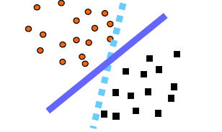
Support Vector Machines
Solid line is preferred
Geometrically we can characterize the solid plane as being “furthest” from both classes
How can we construct the plane “furthest’’ from both classes?

Slide 17
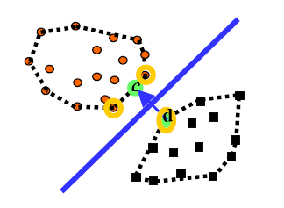
Support Vector Machines
Figure – Best plane bisects closest points in the convex
hulls
Examine the convex hull of each class’ training data (indicated by dotted lines) and then find the closest points in the two convex hulls (circles labeled d and c).
The convex hull of a set of points is the smallest convex set containing the points.
If we construct the plane that bisects these two points (w=d-c), the resulting classifier should be robust in some sense.

Slide 18
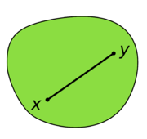
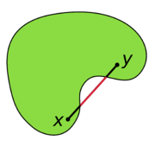
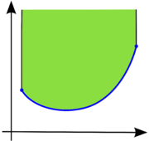
Convex Sets
Convex Set
Non-Convex or Concave Set
A function (in blue) is convex if and only if the region above its graph (in green) is a convex set.

Slide 19
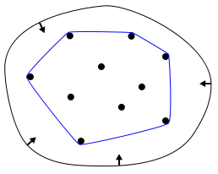
Convex Hulls
Convex hull: elastic band analogy
For planar objects, i.e., lying in the plane, the convex hull may be easily visualized by imagining an elastic band stretched open to encompass the given object; when released, it will assume the shape of the required convex hull.

Slide 20
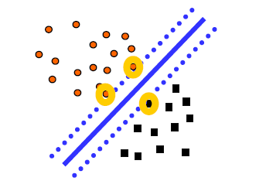
SVM: Margins
Best Plane Maximizes the margin

Slide 21
SVM: Duality
- Maximize margin
- Best plane bisects closest points in the convex
hulls
- Dulaity!!!

Slide 22
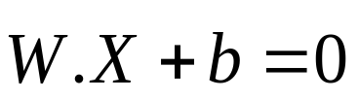


SVM: Mathematics behind it!
2 class problem (multi-class problem)
linearly separable Linearly inseparable)
line (plane, hyper-plane)
Maximal Margin Hyper-plane (MMH)
  2 equidistant parallel hyper-planes on either side of the hyper-plane
Separating Hyper-plane Equation
where is the weight vector = {w1, w2, …,wn}
b is a scalar (called bias)
- Consider 2 input attributes A1 & A2. =(x1,x2)

Slide 23






SVM: Mathematics behind it!
Separating hyper-plane
Any point lying above the SH satisfies
Any point lying below the SH satisfies
Adjusting the weights
Combining, we get
Any training tuple that falls on H1 or H2 satisfies above inequality is called Support Vectors (SVs)
SVs are most difficult tuples to classify & give most important information regarding classification

Slide 24
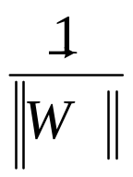
SVM: Size of maximal margin
Distance of any point on H1 or H2 from SH is

Slide 25
SVM: Some Important Points
Complexity of the learned classifier is characterized by the no. of SVs rather than on no. of dimensions
SVs are critical training tuples
If all other training tuples are removed and training were repeated, the same SH would be found
No. of SVs can be used to compute the upper bound on the expected error rate
An SVM with small no. of SVs can have good generalization, even if the dim. of the data is high

Slide 26
SVM: Introduction
Has roots in statistical learning
Arguably, the most important recent discovery in machine learning
Works well for HD data as well
Represents the decision boundary using a subset of training examples called SUPPORT VECTORS
MAXIMAL MARGIN HYPERPLANES

Slide 27
SVM: Introduction
  Map the data to a predetermined very high-dimensional space via a kernel function
  Find the hyperplane that maximizes the margin between the two classes
  If data are not separable find the hyperplane that maximizes the margin and minimizes the (a weighted average of the) misclassifications

Slide 28
Support Vector Machines
Three main ideas:
  Define what an optimal hyperplane is (in way that can be identified in a computationally efficient way): maximize margin
  Extend the above definition for non-linearly separable problems: have a penalty term for misclassifications
  Map data to high dimensional space where it is easier to classify with linear decision surfaces: reformulate problem so that data is mapped implicitly to this space

Slide 29
Which Separating Hyperplane to Use?
Var₁
Var₂

Slide 30
Maximizing the Margin
Var₁
IDEA 1: Select the separating hyperplane that maximizes the margin!
Margin Width
Margin Width
Var₂

Slide 31
Support Vectors
Var₁
Support Vectors
Margin Width
Var₂

Slide 32
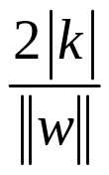


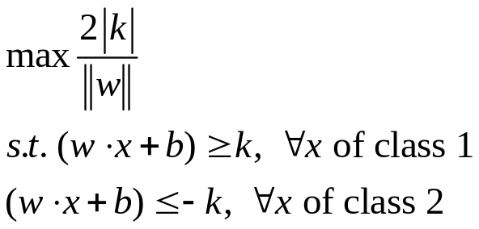



Setting Up the Optimization Problem
Var₁
The width of the margin is:
So, the problem is:
Var₂

Slide 33
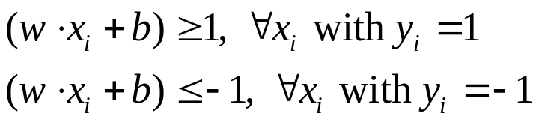

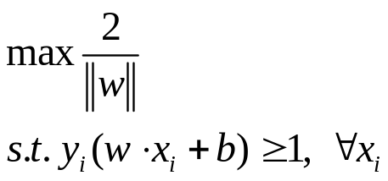
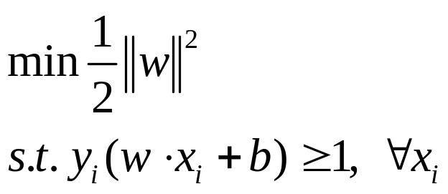
Setting Up the Optimization Problem
If class 1 corresponds to 1 and class 2 corresponds to -1, we can rewrite
as
So the problem becomes:
or

Slide 34
Linear, Hard-Margin SVM Formulation
Find w,b that solves
Problem is convex so, there is a unique global minimum value (when feasible)
There is also a unique minimizer, i.e. weight and b value that provides the minimum
Non-solvable if the data is not linearly separable
Quadratic Programming
  Very efficient computationally with modern constraint optimization engines (handles thousands of constraints and training instances).

Slide 35
Support Vector Machines
Three main ideas:
  Define what an optimal hyperplane is (in way that can be identified in a computationally efficient way): maximize margin
  Extend the above definition for non-linearly separable problems: have a penalty term for misclassifications
  Map data to high dimensional space where it is easier to classify with linear decision surfaces: reformulate problem so that data is mapped implicitly to this space

Slide 36
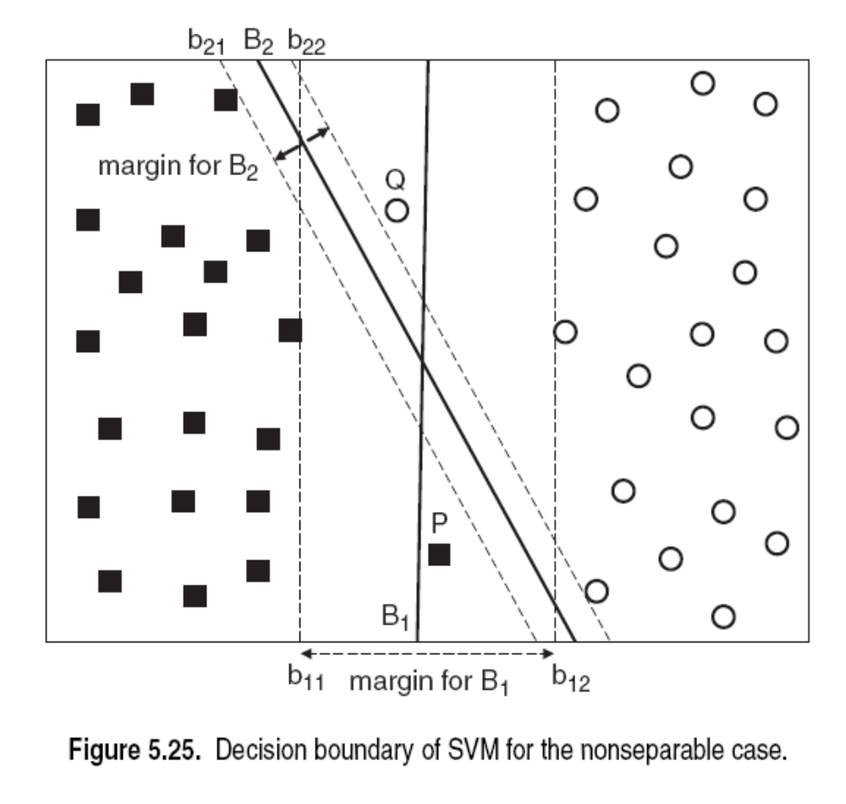
Non-Linearly Separable Data

Slide 37
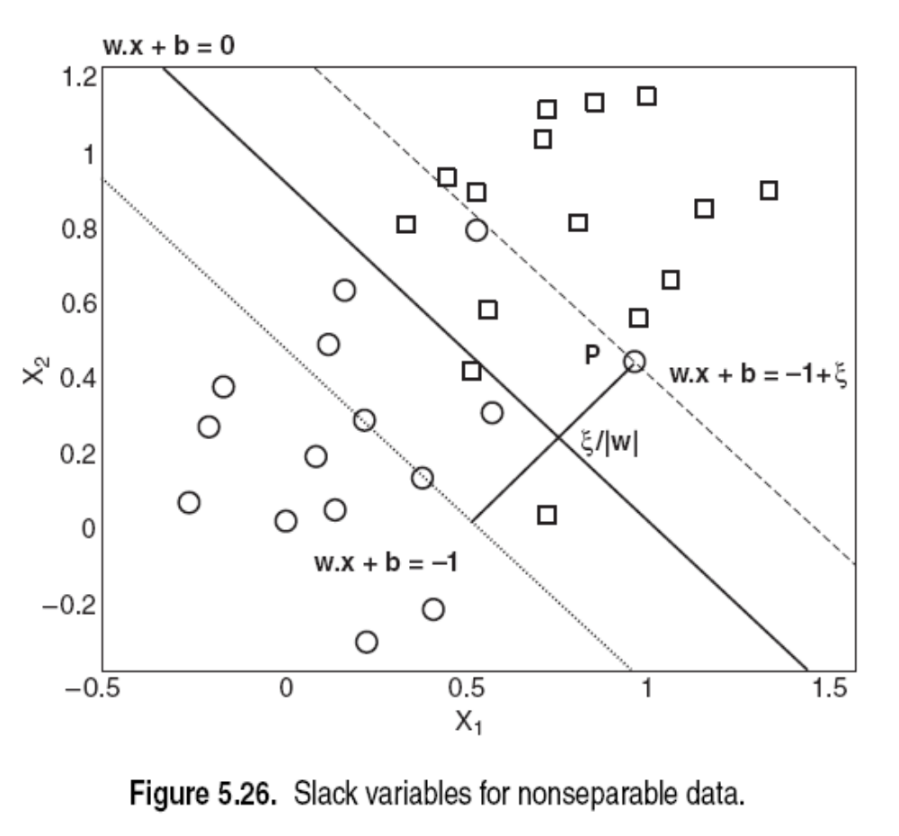

Slide 38
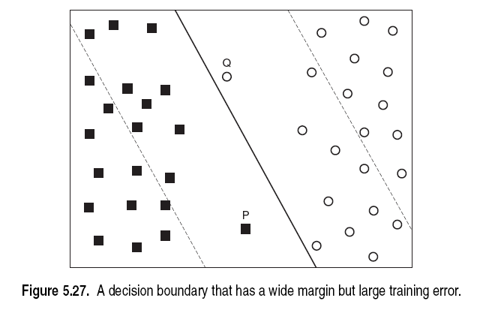

Slide 39




Non-Linearly Separable Data
Var₁
Introduce slack variables
Allow some instances to fall within the margin, but penalize them
Var₂

Slide 40
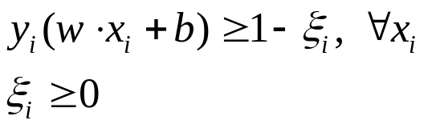
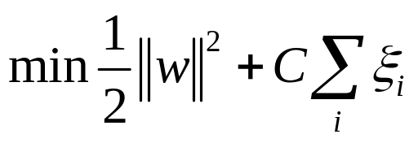
Formulating the Optimization Problem
Constraint becomes :
Objective function penalizes for misclassified instances and those within the margin
C trades-off margin width and misclassifications
Var₁
Var₂

Slide 41
Non-separable data
What if the problem is not linearly separable?
  Introduce slack variables
    Need to minimize:
    Subject to:

Slide 44
Linear, Soft-Margin SVMs
Algorithm tries to maintain ξ_{i} to zero while maximizing margin
Notice: algorithm does not minimize the number of misclassifications (NP-complete problem) but the sum of distances from the margin hyperplanes
Other formulations use ξ_{i}² instead
As C→∞, we get closer to the hard-margin solution

Slide 45
Robustness of Soft vs Hard Margin SVMs
Var₁
Var₁
ξi
Var₂
Var₂
Soft Margin SVN
Hard Margin SVN

Slide 46
Robustness of Soft vs Hard Margin SVMs
Var₁
Var₁
ξi
Soft Margin SVN
Var₂
Var₂
Hard Margin SVN
Soft margin – underfitting
Hard margin – overfitting
Trade-off: width of the margin vs. no. of training errors committed by the linear decision boundary

Slide 47
Robustness of Soft vs Hard Margin SVMs
Var₁
Var₁
ξi
Soft Margin SVN
Var₂
Var₂
Hard Margin SVN
Objective fn. still valid, but constraints need to be relaxed.
Linear separator does not satisfy all the constraints
Inequality constraints need to relaxed a bit to accommodate the nonlinearly separable data.

Slide 48
Support Vector Machines
Three main ideas:
  Define what an optimal hyperplane is (in way that can be identified in a computationally efficient way): maximize margin
  Extend the above definition for non-linearly separable problems: have a penalty term for misclassifications
  Map data to high dimensional space where it is easier to classify with linear decision surfaces: reformulate problem so that data is mapped implicitly to this space

Slide 49
Disadvantages of Linear Decision Surfaces
Var₁
Var₂

Slide 50
Advantages of Non-Linear Surfaces
Var₁
Var₂

Slide 51
Linear Classifiers in High-Dimensional Spaces
Constructed Feature 2
Var₁
Var₂
Constructed Feature 1
Find function Φ(x) to map to a different space

Slide 52
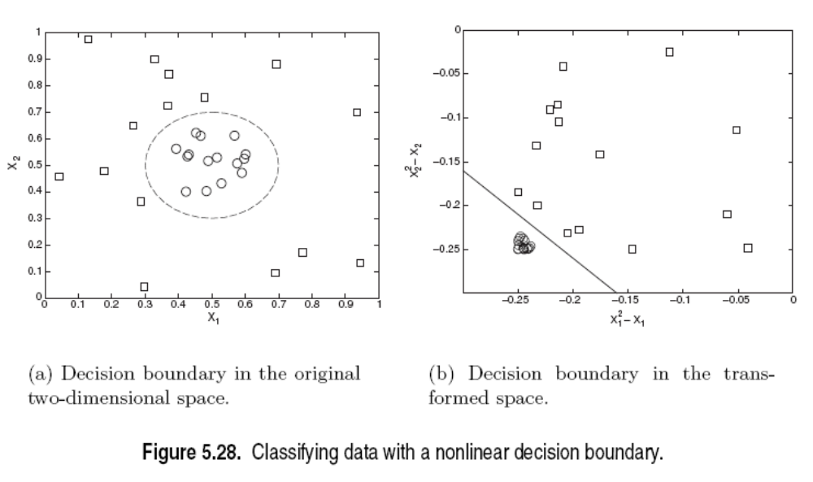

Slide 53
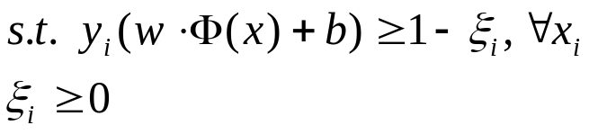
Mapping Data to a High-Dimensional Space
Find function Φ(x) to map to a different space, then SVM formulation becomes:
Data appear as Φ(x), weights w are now weights in the new space
Explicit mapping expensive if Φ(x) is very high dimensional
Solving the problem without explicitly mapping the data is desirable

Slide 54
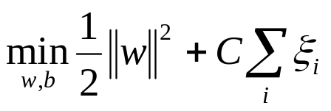
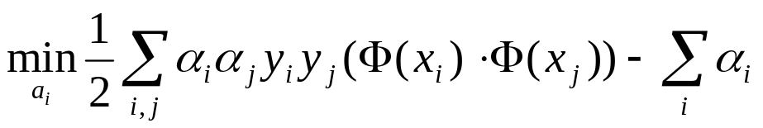
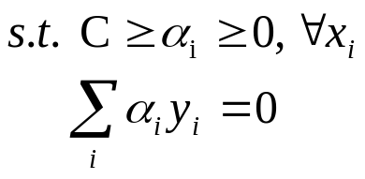
The Dual of the SVM Formulation
Original SVM formulation
  n inequality constraints
  n positivity constraints
  n number of ξ variables
The (Wolfe) dual of this problem
  one equality constraint
  n positivity constraints
  n number of α variables (Lagrange multipliers)
  Objective function more complicated
NOTICE: Data only appear as Φ(x_{i}) ⋅ Φ(x_{j})

Slide 55
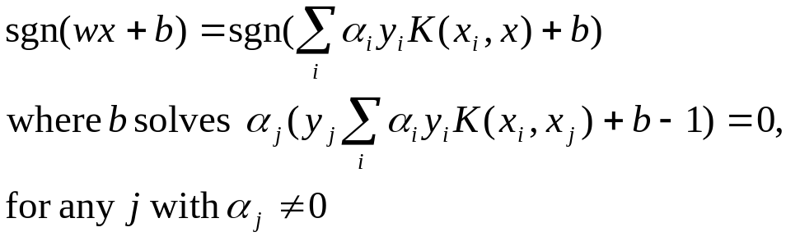
The Kernel Trick
Φ(x_{i}) ⋅ Φ(x_{j}): means, map data into new space, then take the inner product of the new vectors
We can find a function such that: K(x_{i} ⋅ x_{j}) = Φ(x_{i}) ⋅ Φ(x_{j}), i.e., the image of the inner product of the data is the inner product of the images of the data
Then, we do not need to explicitly map the data into the high-dimensional space to solve the optimization problem (for training)
How do we classify without explicitly mapping the new instances? Turns out

Slide 56

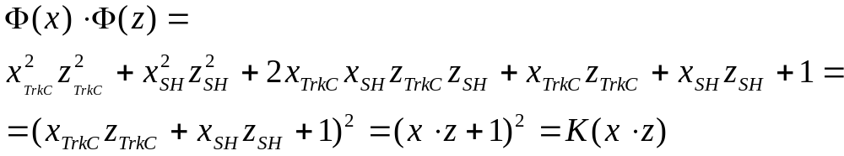
Examples of Kernels
Assume we measure two quantities, e.g. expression level of genes TrkC and SonicHedghog (SH) and we use the mapping:
Consider the function:
We can verify that:

Slide 57

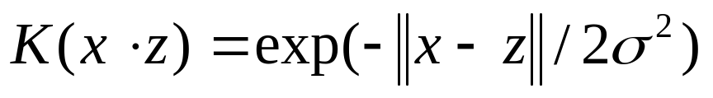
Polynomial and Gaussian Kernels
is called the polynomial kernel of degree p.
For p=2, if we measure 7,000 genes using the kernel once means calculating a summation product with 7,000 terms then taking the square of this number
Mapping explicitly to the high-dimensional space means calculating approximately 50,000,000 new features for both training instances, then taking the inner product of that (another 50,000,000 terms to sum)
In general, using the Kernel trick provides huge computational savings over explicit mapping!
Another commonly used Kernel is the Gaussian (maps to a dimensional space with number of dimensions equal to the number of training cases):

Slide 58
The Mercer Condition
Is there a mapping Φ(x) for any symmetric function K(x,z)? No
The SVM dual formulation requires calculation K(x_{i} , x_{j}) for each pair of training instances. The array G_{ij} = K(x_{i} , x_{j}) is called the Gram matrix
There is a feature space Φ(x) when the Kernel is such that G is always semi-positive definite (Mercer condition)

Slide 59
Kernels
Decision hyper planes found for NLSVM are the same types as those found by NN classifiers
SVM with a Gaussian Radial Bias Function (RBF) gives the same HP as a RBF network.
SVM with sigmoidal kernel is equivalent to a 2-layer NN known as a multi-layer perceptron (with no hidden layers)
No golden rule for determining which admissible Kernel will result in the most accurate SVM
In practice, kernels chosen does not generally make a large diff. in accuracy!
SVMs always find a global solution!

Slide 60
Other Types of Kernel Methods
SVMs that perform regression
SVMs that perform clustering
ν-Support Vector Machines: maximize margin while bounding the number of margin errors
Leave One Out Machines: minimize the bound of the leave-one-out error
SVM formulations that take into consideration difference in cost of misclassification for the different classes
Kernels suitable for sequences of strings, or other specialized kernels

Slide 61
Variable Selection with SVMs
Recursive Feature Elimination
  Train a linear SVM
  Remove the variables with the lowest weights (those variables affect classification the least), e.g., remove the lowest 50% of variables
  Retrain the SVM with remaining variables and repeat until classification is reduced
Very successful
Other formulations exist where minimizing the number of variables is folded into the optimization problem
Similar algorithm exist for non-linear SVMs
Some of the best and most efficient variable selection methods

Slide 62
Comparison with Neural Networks
Neural Networks
Hidden Layers map to lower dimensional spaces
Search space has multiple local minima
Training is expensive
Classification extremely efficient
Requires number of hidden units and layers
Very good accuracy in typical domains
SVMs
Kernel maps to a very-high dimensional space
Search space has a unique minimum
Training is extremely efficient
Classification extremely efficient
Kernel and cost the two parameters to select
Very good accuracy in typical domains
Extremely robust

Slide 63
Why do SVMs Generalize?
Even though they map to a very high-dimensional space
  They have a very strong bias in that space
  The solution has to be a linear combination of the training instances
Large theory on Structural Risk Minimization providing bounds on the error of an SVM
  Typically the error bounds too loose to be of practical use

Slide 64
MultiClass SVMs
One-versus-all
  Train n binary classifiers, one for each class against all other classes.
  Predicted class is the class of the most confident classifier
One-versus-one
  Train n(n-1)/2 classifiers, each discriminating between a pair of classes
  Several strategies for selecting the final classification based on the output of the binary SVMs
Truly MultiClass SVMs
  Generalize the SVM formulation to multiple categories
More on that in the nominated for the student paper award: “Methods for Multi-Category Cancer Diagnosis from Gene Expression Data: A Comprehensive Evaluation to Inform Decision Support System Development”, Alexander Statnikov, Constantin F. Aliferis, Ioannis Tsamardinos

Slide 65
Conclusions
SVMs express learning as a mathematical program taking advantage of the rich theory in optimization
SVM uses the kernel trick to map indirectly to extremely high dimensional spaces
SVMs extremely successful, robust, efficient, and versatile while there are good theoretical indications as to why they generalize well

Slide 66
Suggested Further Reading
http://www.kernel-machines.org/tutorial.html
C. J. C. Burges. A Tutorial on Support Vector Machines for Pattern Recognition. Knowledge Discovery and Data Mining, 2(2), 1998.
P.H. Chen, C.-J. Lin, and B. Schölkopf. A tutorial on nu -support vector machines. 2003.
N. Cristianini. ICML'01 tutorial, 2001.
K.-R. Müller, S. Mika, G. Rätsch, K. Tsuda, and B. Schölkopf. An introduction to kernel-based learning algorithms. IEEE Neural Networks, 12(2):181-201, May 2001. (PDF)
B. Schölkopf. SVM and kernel methods, 2001. Tutorial given at the NIPS Conference.
Hastie, Tibshirani, Friedman, The Elements of Statistical Learning, Springel 2001

Slide 67
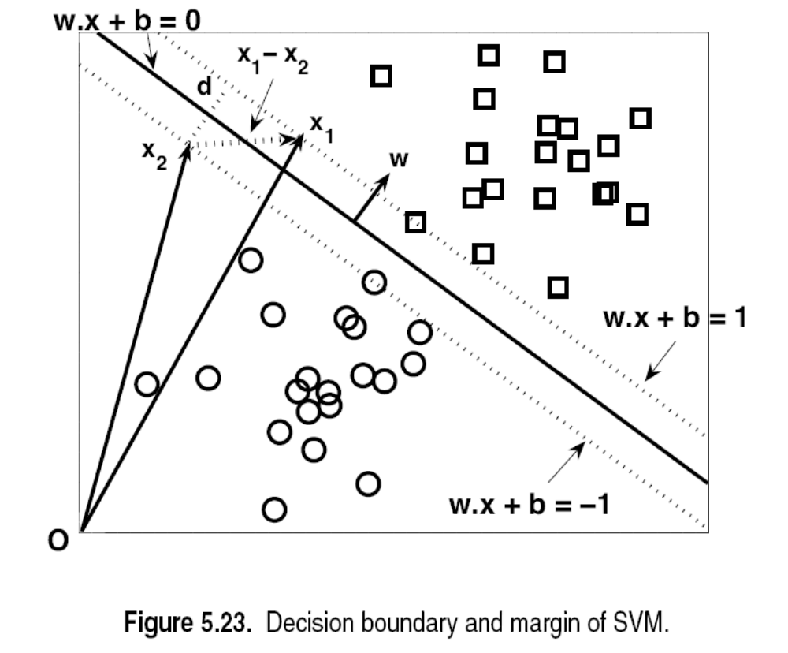

Slide 69
